Slide 1
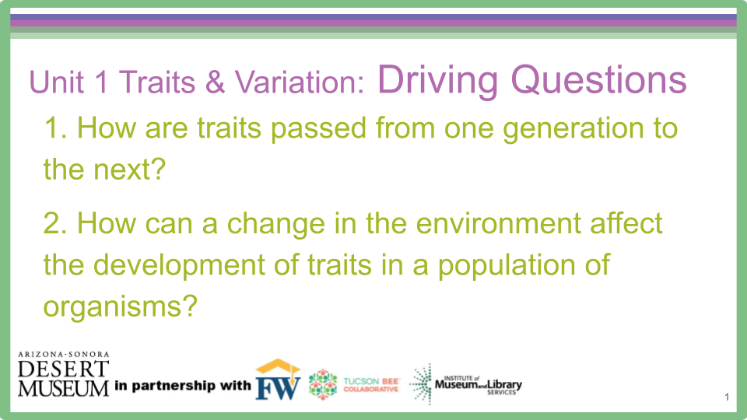

Unit 1, Traits and Variation: Driving Questions
How are traits passed from one generation to the next?
How can a change in the environment affect the development of traits in a population of organisms?

Slide 2
Lesson Prep: 2 weeks prior to Engage Day 1

Slide 3
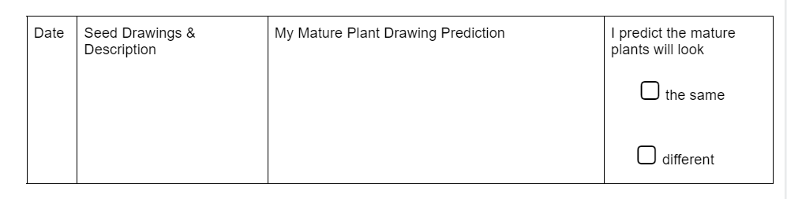
All these seeds are from the same kind, same species, of plant.
With your group, take a look at the seeds. Write your observations and draw what you see on your Student Handout.
Include: texture, color, size
Draw your prediction of the mature plant. Predict if the mature plants will all look the same or different.
Notes:
Have students use magnifying glasses and make observations of their seeds. They are to draw and label what they see on Traits and Variation Student Handout #1. They are also to draw what they think the mature plant will look like. Encourage conversations about different sizes, shapes, colors and textures of seeds. Ask students to predict if they think all the mature plants will look the same or different - you may choose to do “Go To Your Corner” at this time - refer to Teacher Lesson Plan for description of activity.

Slide 4
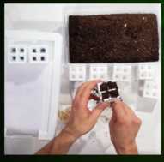
So how should we test our predictions???
Let’s plant!
Wisconsin Fast Plants video
Notes:
See Teacher Lesson Plan for Materials needed. The Materials Needed depend on if you do or do not have Wisconsin Fast Plants. Students will be planting their seeds. Following your Seed Supplier’s instructions, have students plant their seeds. After students have planted their seeds, have students put the seeds in the area you designate. The link on the slide (click on Wisconsin Fast Plants link when in slide show mode or select https://fastplants.org/grow-fast-plants-2/preparation/) leads to very helpful links and videos for the teacher to explore and learn how to have the best success with growing the plants. Look at Notes in Unit #1 Lesson Plan for helpful suggestions on lighting and planting as well.

Slide 5
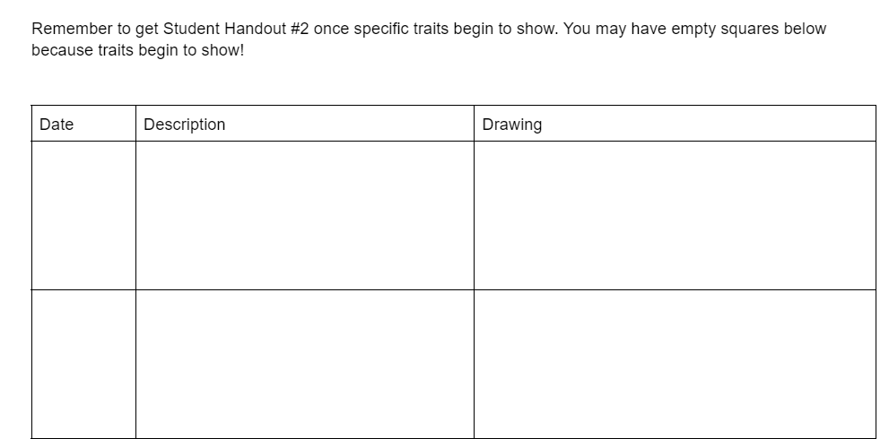
For the next two weeks you will need to:
Water your plants carefully.
Make observations by drawing and describing what you see.
As soon as specific traits emerge, you will need Student Handout #2.
Once you see specific traits, you will confirm or adjust your prediction on if mature plants look the same or different.
Notes:
Inform students that they will need to water the seeds daily and record observations. Encourage students to be detailed in their descriptions and drawings. Students should label drawings. Tell students that if there is no growth, they simply record the fact they watered the seeds and there is no growth or change. As soon as traits become clearly evident, students will need Student Handout #2. Since seeing Student Handout #2 shows what traits emerge, do not let students have the handout until traits are clearly evident.Tell students it is OK if they have not filled out every square on Student Handout #1. Once students get Student Handout #2, they will be able to confirm or adjust their prediction on if the mature plants in their group’s plantings all look the same or if there are differences between them.

Slide 6
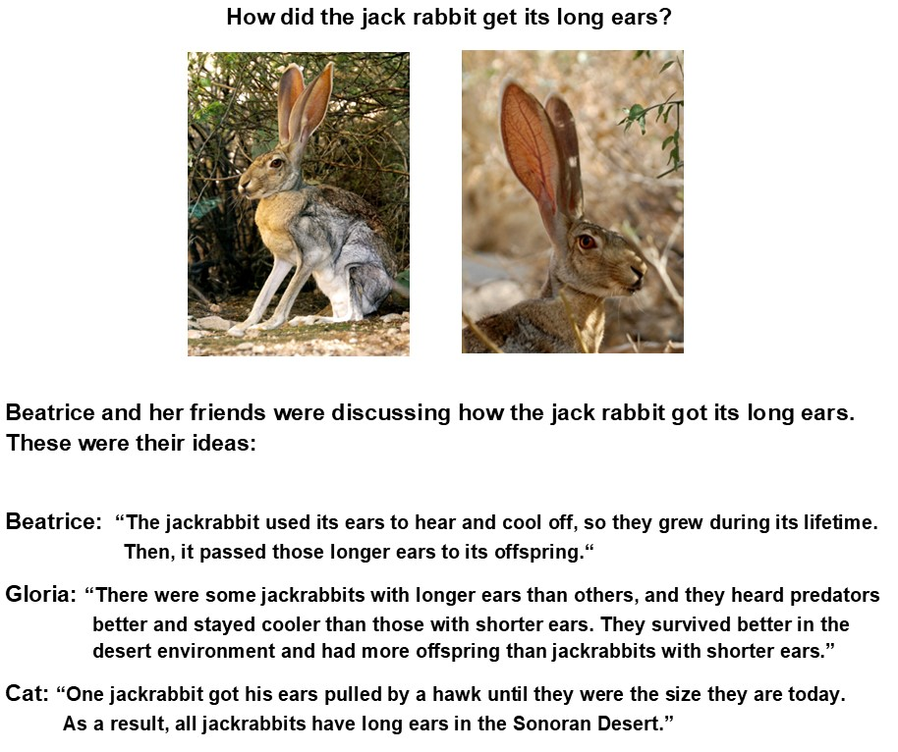

ENGAGE - PROBE
On a post-it, write your name.
Place your name by the person with whom you agree.
Be ready to share why you agree with the person you chose.
Beatrice | Gloria | Cat
Notes:
Need WonderWall area ready, Driving Questions posted, Student Handout #2, post its, names of students on Probe posted. Once traits have been clearly evident and students have been recording data on Student Handout # 2, students read probes in their groups (Teacher must make copies) or Teacher can lead this as a whole class. Students then discuss which person they agree with and why. Students write their name on a post-it note and place their post-it by the name they agree with on the Probe. Teacher leads discussion to hear the students’ thoughts.

Slide 7
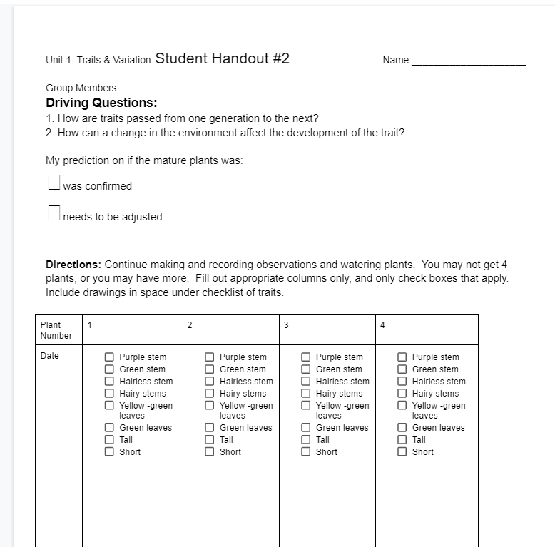
Let’s look at Student Handout #2
Water plants daily.
Record observations on handout.
Include drawings in space underneath checklist.
Drawings here - draw close up
images
Notes:
Ensure that students understand they must keep watering plants and making and recording observations. Drawings have limited space so encourage students to draw close up images of plants - focused on traits.

Slide 8
EXPLORE 1
Let’s get our seedlings and make some observations.
Notes:
Need student seedlings, magnifying glasses,Traits and Variation Student Handouts #1 and #2

Slide 9
Shortest person in science group shares data first
Everyone in the group needs to share their recorded data and drawings on their Student Handout
With your group, examine your seedlings and discuss what you see after 2 weeks of growth.
Notes:
Students get plants and discuss the changes in their plants and the traits that they observed emerge over the 2 weeks. Teacher reminds students of Go to Your Corner and students confirm or adjust their predictions about the mature plants all looking the same or different.

Slide 10
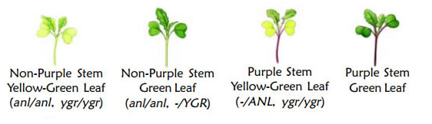
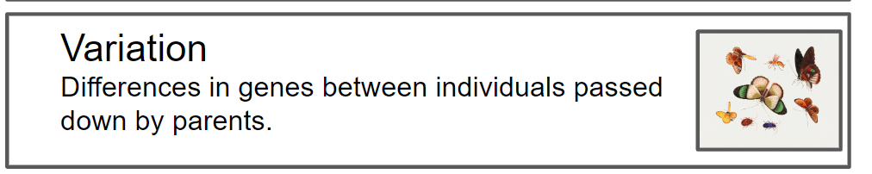
Discuss with your group why you think there is considerable variation. Would it be good for a species to have a variety of traits? Why or why not?
Notes:
Have students discuss why they think such variation within a similar species exists. Teacher may have to guide students to the fact that different traits may allow for a species to survive different environmental conditions - it helps a species survive if they have variation within their species.

Slide 11
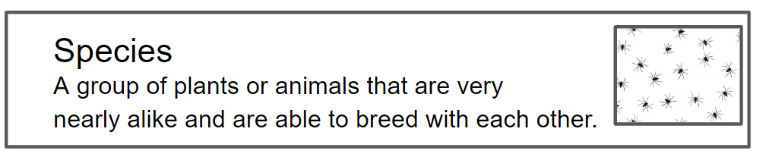
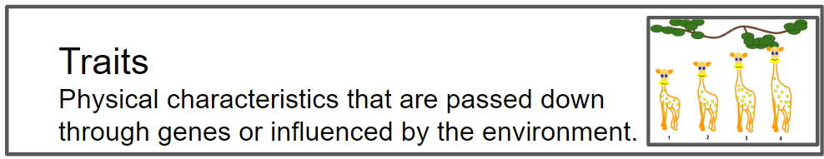
EXPLAIN Let’s talk about the words “species” & “traits”
Notes:
Teacher reminds students that all the plants are the same species, but there is considerable variation of traits. Teacher then asks students how they think scientists determine what organisms belong to which species. Students will likely bring up that scientists would look for how the organisms looked similar.

Slide 12
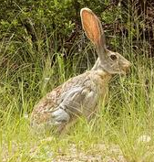
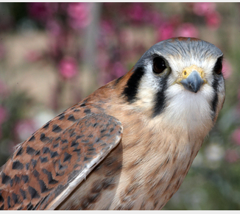
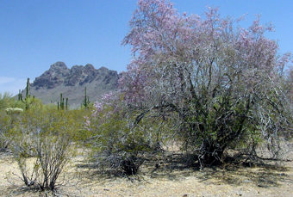
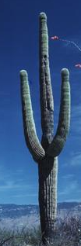
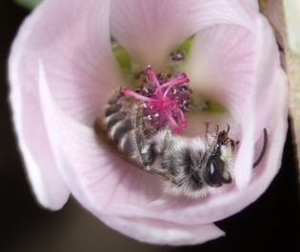
Physical Traits =
feathers
fur
skin
bark
height
2, 4 or more legs
flowers and leaves
branches
Notes:
Teacher explains that scientists look for similar traits in species. The teacher then explains traits are things like fur color, feathers, scales, 2 legs, fins, branches, flowers, leaves, etc.

Slide 13
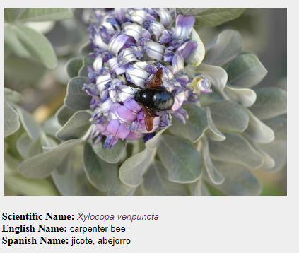
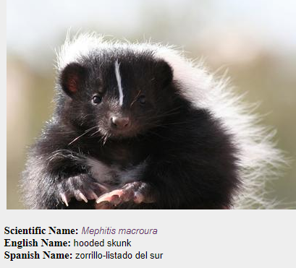
Share with a neighbor some traits you see
Notes:
Students practice with a partner listing physical traits of the skunk, bee and the flower the bee is pollinating such as color, furry, leaves, claws, etc.

Slide 14

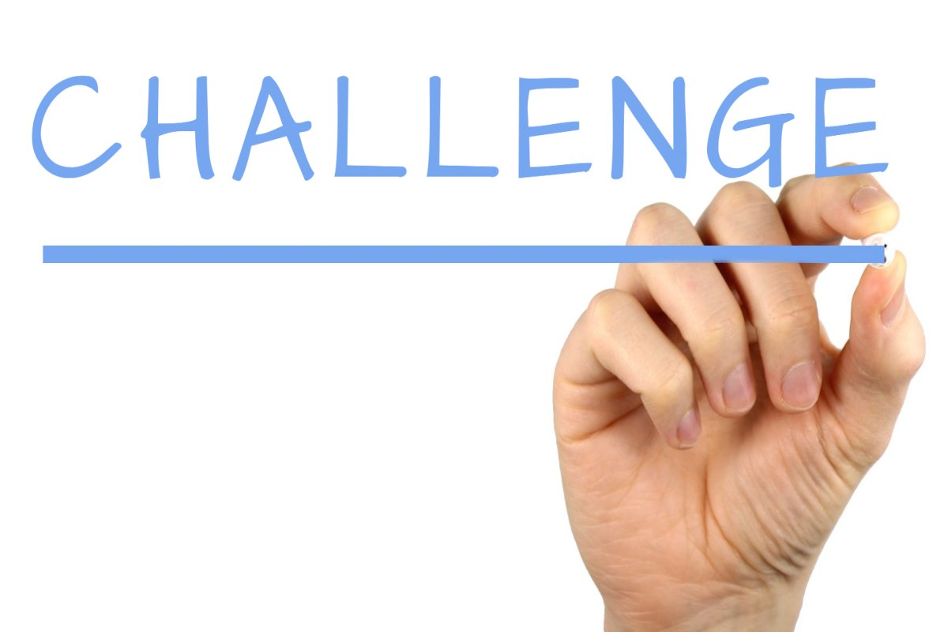
Same Species? Yes or No???
Looking at the next several slides, your group needs to put Heads Together to determine if all the animals in the photos are the same species.
You will reveal your conclusions with a
Be ready to defend your thinking
Your Group’s Challenge:
Based on similar traits, group animals into species.
Notes:
Students practice looking at photos of animals and based on their traits to determine if the images are all of the same species or not. Students look at given images, put their Heads Together in thier group and give a Thumbs Up if they think the images are all of the same species, or a Thumbs Down if they think the images are not of the same species. Students must explain their thinking and point out what traits the organism has that helped the student decide to give a Thumbs up or a Thumbs Down.

Slide 15
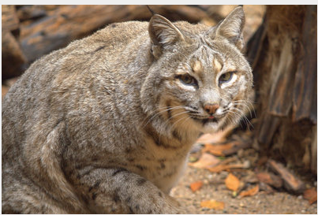
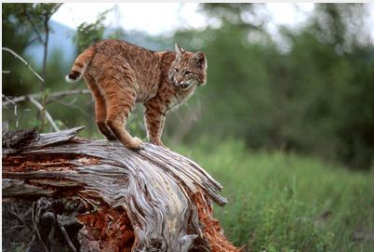

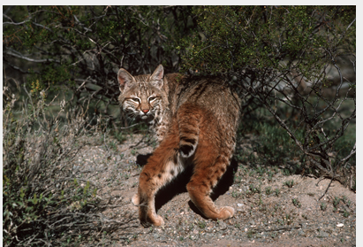
Are these all the same species? Why do you think so?
YES!
Bobcat
Notes:
All images are bobcats - point out they don’t look exactly the same. Have students defend answer with why they believe all animals are or are not the same species. Students need to share what traits helped them determine if the images were of the same species or not.

Slide 16
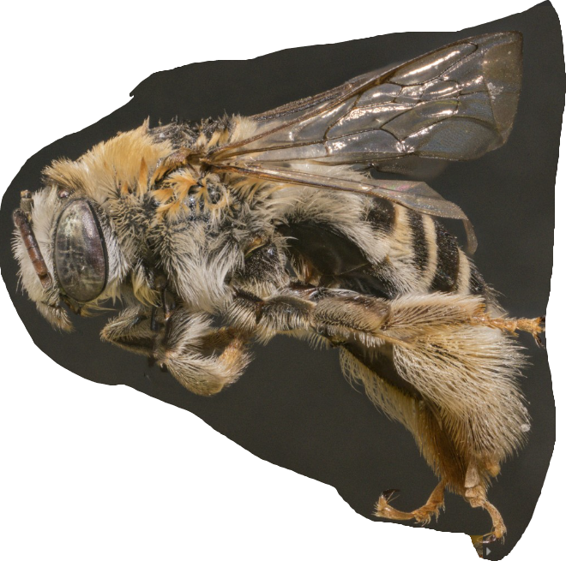
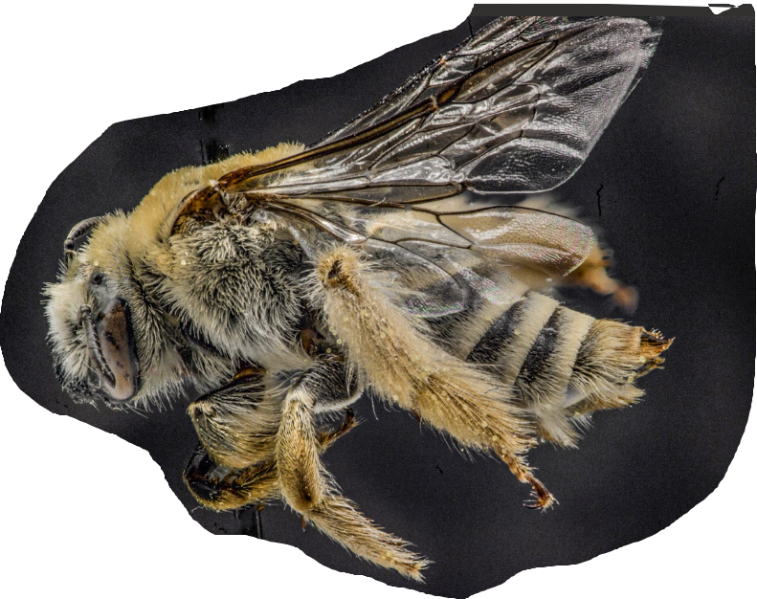
Are these all the same species? Why do you think so?
NO!
Longhorn Bee
Cactus Bee
Notes:
Continue having students defend their thinking aloud.

Slide 17
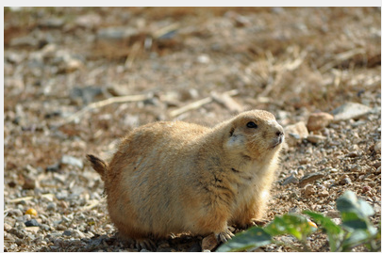
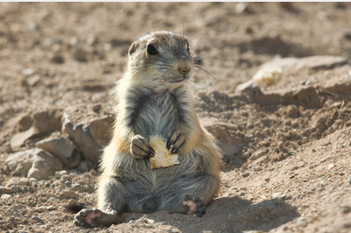
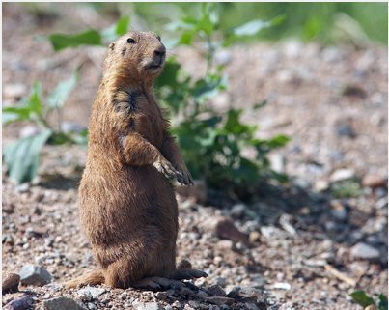
Are these all the same species? Why do you think so?
YES!
Black-tailed prairie dog
Notes:
All images are black-tailed prairie dogs - point out they don’t look exactly the same- Have students defend answer with why they believe all animals are or are not the same species. Students need to share what traits helped them determine if the images were of the same species or not.

Slide 18
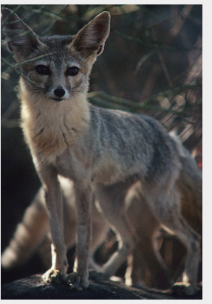
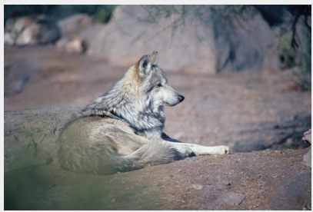
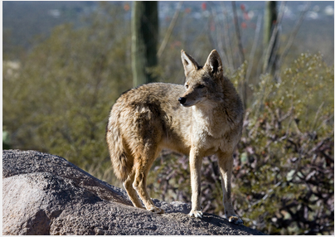
Are these all the same species? Why do you think so?
NO!
Wolf, fox, and coyote
Notes:
Let students know that identifying species is NOT easy, and diferent physical features don’t always differentiate species. Again students must defend their thinking by stating the traits they saw that made them determine their answer.

Slide 19
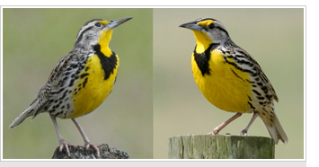

Are these all the same species? Why do you think so?
No!
Western Meadowlark
Eastern Meadowlark
Notes:
Let students know identifying species is difficult! Due to great variation, scientists argue about species identification.

Slide 20
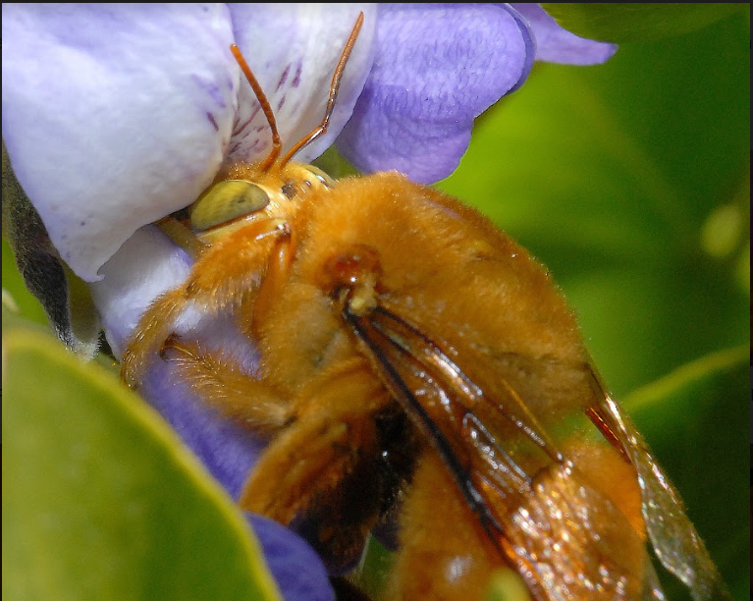
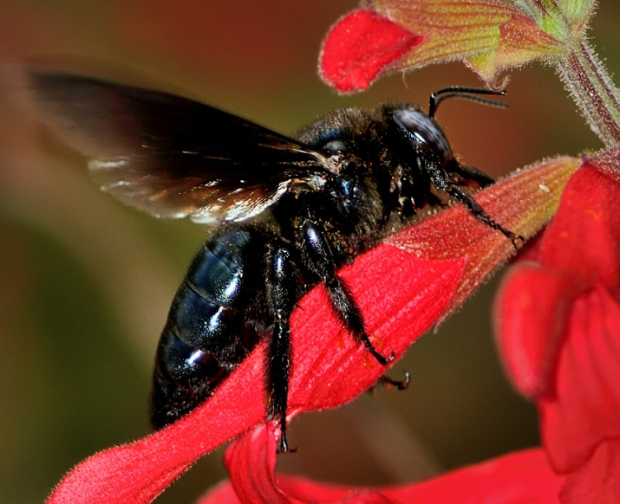
Are these all the same species? Why do you think so?
Yes!
Female Carpenter bee
Male Carpenter bee
Notes:
The female Carpenter Bee is black.

Slide 21

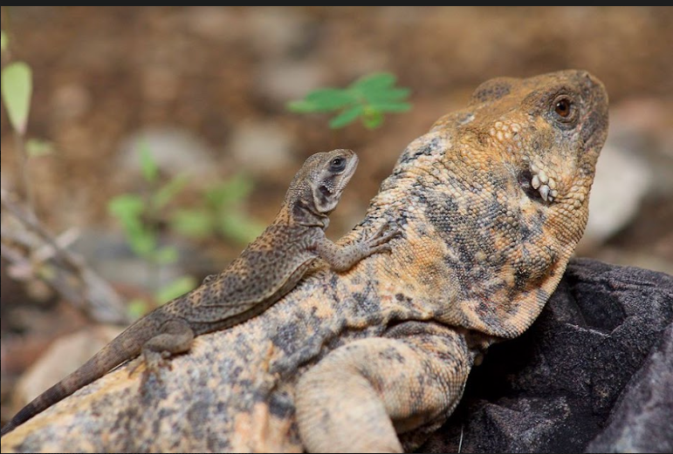

We can claim that offspring look like their parents, but the offspring will have variation in their traits. But WHY do offspring look like their parents?
Be ready to share a “WOW!” or an “I WONDER?”
What is DNA for Kids video
Notes:
Show short video by clicking on video link in slide show mode (or follow link https://www.youtube.com/watch?v=921XdtoRAoo&t=2s). Have students jot down a Wow and an I Wonder on slates or just discuss as a class

Slide 22
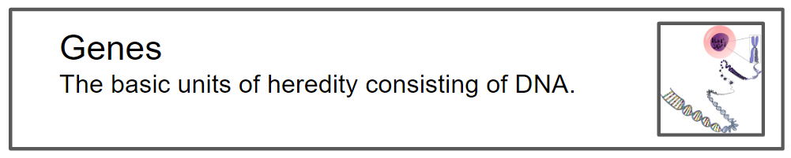
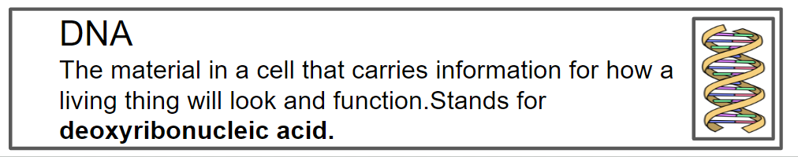
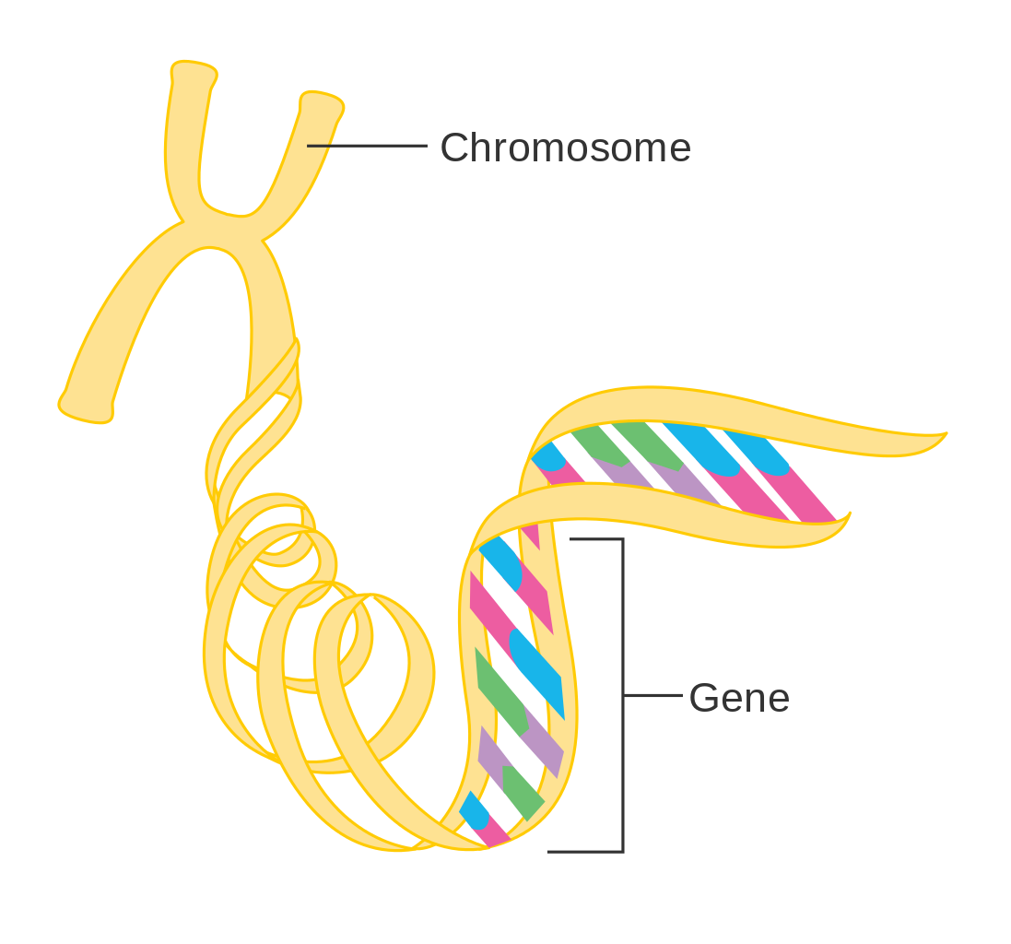
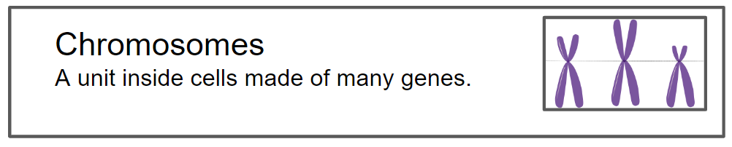
An organism’s cells contain chromosomes.
Chromosomes contain genes.
Genes are made of DNA and carry the coding of an organism’s traits.
Notes:
Have students share their Wows and Wonders from the video. Then begin reviewing information from video on this slide and the next 2 slides

Slide 23

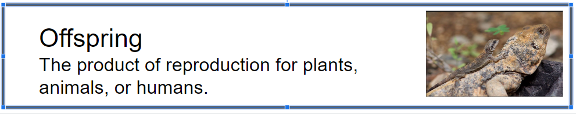
Offspring look like their
parents because of heredity - the passing on of traits:
Notes:
This slide is reviewing information from video

Slide 24
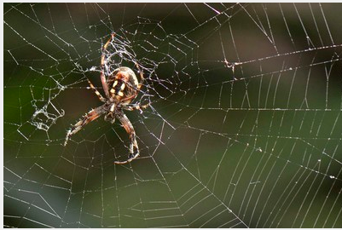
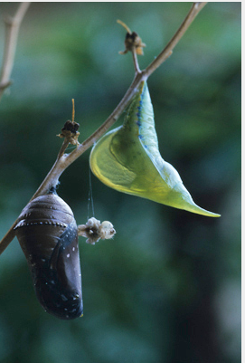
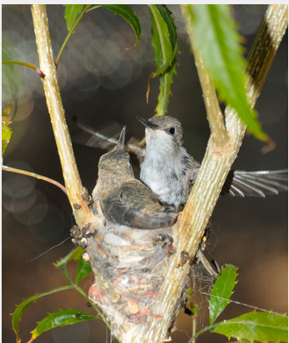
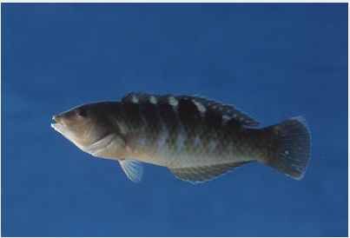
Inherited Traits
Spider spinning a web | Caterpillar making a chrysalis
Bird building a nest | Fish swimming
Parents pass physical traits and instinctive behaviors to their offspring.
The images on the right show instinctive behaviors.
Notes:
Discuss information displayed on side. All images are of inherited traits.

Slide 25
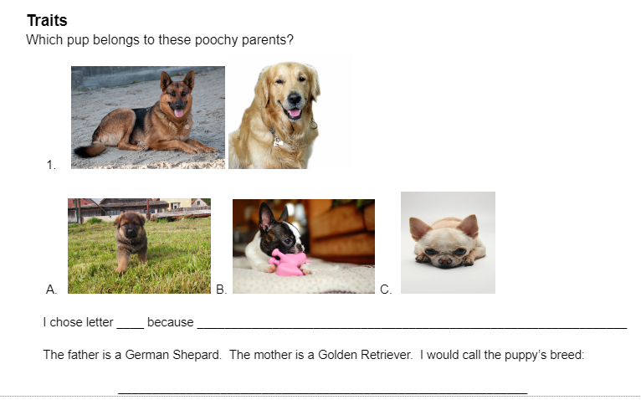
Whoa! That’s a lot of information!
Let’s help some pups find their poochy parents
Work with your group!
Be ready to share and discuss!
Make sure you explain why you chose the pup you did.
Notes:
Students practice applying what they learned about traits and species by working together by matching a pup to their Poochy Parents on Traits and Variation Handout #2. Have students work in their groups on Traits and Variation Student Handout #2. (Most reasonable answer is A due to the German Shepard markings and size)

Slide 26
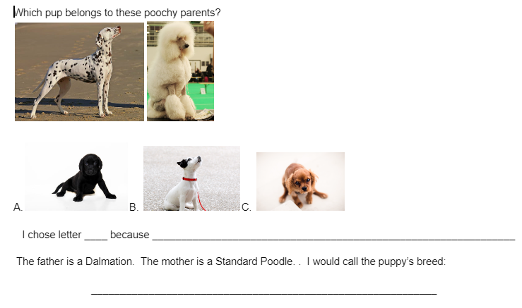
Notes:
Have a class discussion after groups finish on why they chose their answers. Have fun with their pup’s new breed name!! (B is most reasonable answer due to coloring)

Slide 27
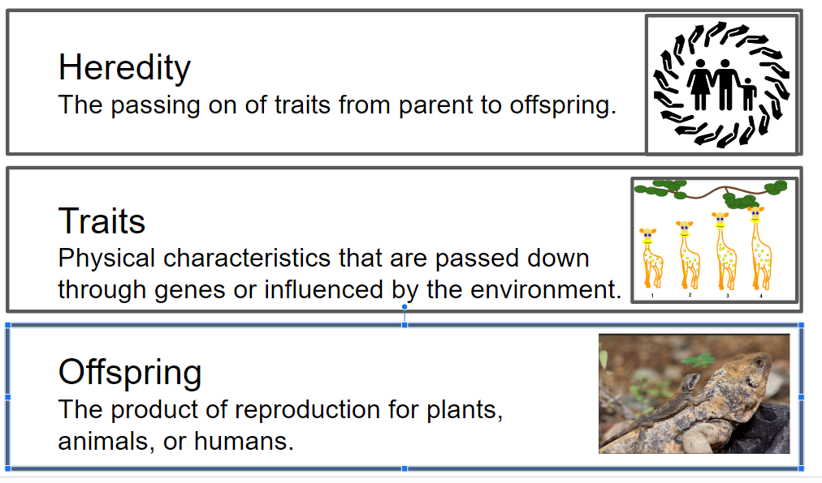
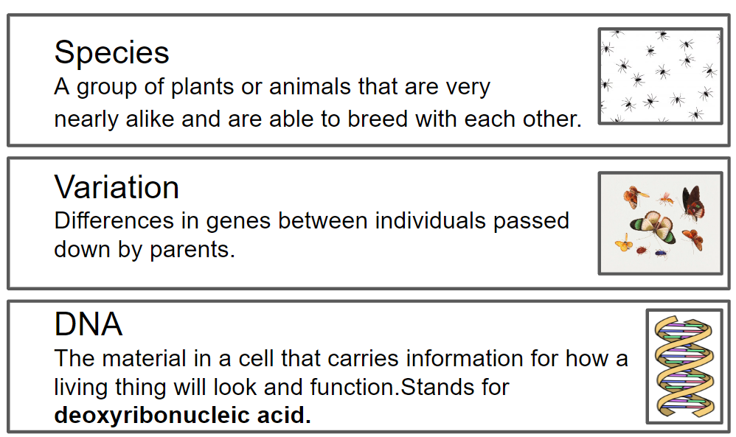
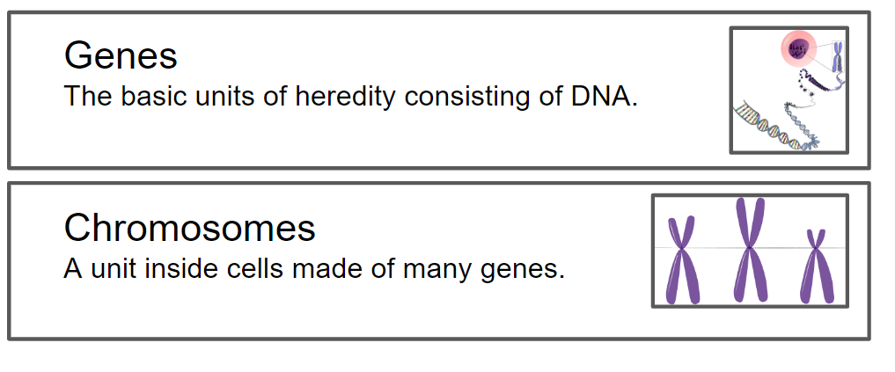
Time to work on our vocab!
To wrap up today’s learning, let’s work on our vocabulary!
Notes:
Students end the lesson by working with a partner on learning the 8 vocabulary words from the unit. See lesson plan for some suggested strategies for students cooperatively learning the vocabulary. Teacher may choose to print off Student Vocabulary cards for more practice independently or at centers, etc.

Slide 28
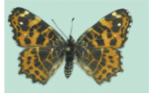
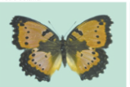
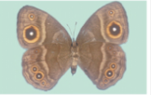



ELABORATE We know variation in species occurs. Look at the variation of the 3 butterfly species below (compare photos top to bottom)…
With your group, Heads Together, what do you think caused the variation?
Araschnia levana | Precis octavia | Bicyclus anynana
Notes:
Teacher needs to guide students to that they need to compare the photos from top to bottom. Kids work in groups with Heads Together to discuss what may have caused the wing variation within the species from the top to bottom picture. After listening to student responses, Teacher then reveals the reason why there is great variation on the next slide

Slide 29
We know variation in species occurs. Look at the variation of the 3 butterfly species below (compare photos top to bottom)…
With your group, Heads Together, what do you think caused the variation?
Araschnia levana | Precis octavia | Bicyclus anynana
Notes:
Teacher needs to guide students to that they need to compare the photos from top to bottom. Kids work in groups with Heads Together to discuss what may have caused the wing variation within the species from the top to bottom picture. After listening to student responses, Teacher then reveals the reason why there is great variation on the next slide

Slide 30
Sorting cards
With a Partner, you will sort the given cards into two separate columns: Inherited Traits or Traits Affected by the Environment
Have one Partner title their slate DNA (for Inherited)
Have the other Partner title their slate
ENV (for traits affected by environment)
Sort the cards onto their appropriate slate.
Both partners raise hands when you think you are done and feel you are correct.
A plant is fertilized and bears more fruit. | A spider spins a web.
A palo verde tree has a green trunk and branches. | A bobcat cub is born with spots.
In a dark closet, a plant’s leaves turn yellow. | A chihuahua is very overweight.
A hawk moves to a golf course to hunt rabbits. | White-winged doves feed at a bird feeder.
A girl is born with brown eyes. | A desert pupfish swims in a stream.
A zebra-tailed lizard loses its tail to a predator. | A kangaroo rat has specialized, modified kidneys.
Notes:
Teacher then gives students Traits & Variation Sort cards. With a partner students sort the cards into 2 groups. One student writes DNA, for inherited traits, on their slate, the other student writes ENV, for traits Affected by the environment on their slate. Students then read cards and place them onto the slate they believe the card belongs to. After students have done their first round of sorting, Teacher can lead the class in questions to find out how many groups put which traits into which group.
Questions to consider at the end:
Why did you place your cards where you did? Did you get stuck on any examples? Why? Can you think of other examples of inherited traits? Can you think of other examples of traits affected by the environment?

Slide 31

Inherited Traits are only part of the picture
Traits
affected
by the
environment
Inherited
Traits
(DNA)
Notes:
Students watch a Fuse School video on Traits Affected by the Environment (video link not provided until Slide 33). Students then re-visit their Sort and decide if any cards should be moved. Teacher leads the class in a discussion of what cards they moved and why they changed their thinking. Teacher then reveals the correct answers.

Slide 32

Traits Affected by the Environment
Occurs from an animal interacting with its environment
Notes:
Encourage students to think of other traits that are affected by the environment

Slide 33

Examples of Traits Affected by the Environment
A spider exposed to caffeine spins irregular webs
A tomato plant can bear more fruit if given the right fertilizer
A cat can become obese from too many cat treats
Notes:
more examples: A sea turtle can lose a flipper in a collision with a boat, a normally tall sunflower plant can be stunted by being grown in the dark, a tiger cub learns to hunt prey by watching its parents, a chimpanzee can learn sign language

Slide 34

Let’s watch Fuse School’s video on traits
Nature vs Nurture video
Be ready to share your thinking and wonderings
Notes:
Students watch a Fuse School video on Traits Affected by the Environment (Play by clicking link on Nature vs Nuture in slide show mode or access on You Tube here: https://www.youtube.com/watch?app=desktop&si=TUonSlrB4bOGYbBS&t=1&v=EmctxRcmloc&feature=youtu.be). Have students share thinkings and wonderings aloud after video.

Slide 35
Revisit Your Sort - Do you need to change any cards?
A plant is fertilized and bears more fruit. | A spider spins a web.
A palo verde tree has a green trunk and branches. | A bobcat cub is born with spots.
In a dark closet, a plant’s leaves turn yellow. | A chihuahua is very overweight.
A hawk moves to a golf course to hunt rabbits. | White-winged doves feed at a bird feeder.
A girl is born with brown eyes. | A desert pupfish swims in a stream.
A zebra-tailed lizard loses its tail to a predator. | A kangaroo rat has specialized, modified kidneys.
Notes:
Students re-visit their Sort and decide if any cards should be moved. Teacher leads the class in a discussion of what cards they moved and why they changed their thinking. Teacher then reveals the correct answers on next slide

Slide 36
Card Sort Answers
DNA (INHERITED TRAITS) | ENV-(TRAITS AFFECTED BY THE ENVIRONMENT)
A spider spins a web. | A plant is fertilized and bears more fruit.
A palo verde tree has a green trunk and branches. | In a dark closet, a plant’s leaves turn yellow.
A bobcat cub is born with spots. | A chihuahua is very overweight.
A kangaroo rat has specialized, modified kidneys. | White-winged doves feed at a bird feeder.
A girl is born with brown eyes. | A zebra-tailed lizard loses its tail to a predator.
A desert pupfish swims in a stream. | A hawk moves to a golf course to hunt rabbits.
Notes:
Teacher leads class discussion to process answers and any student misconceptions

Slide 37
EXPLORE Part 2 Testable Wonder
How could we test our plants’ traits being affected by the environment?
We can change the growing variables!
What if we focus on the amount of light our plants get and how this might affect the development of traits in our plants??? How could we test this????
Notes:
Teacher leads students to come up with an environmental variable the class could test to monitor the effects the environmental variable has on the plants’ traits.Teacher listens to students’ thinking. Refer to Teacher Lesson plan for ideas on changing variables such as amount of water, temperature, etc. This controls for 1 variable only - which is a good place to start. After testing for just the variable of light, students could change variables of their choosing. Light is an easy variable in a classroom to manipulate. Students get their seedlings and half of the student groups put their plants somewhere in the room where they get much less light exposure than the other groups' plants. If students are testing other variables, instruct students accordingly. Have students mark on Student Handout #2 if their plant is getting light or not. If there is a place in the classroom where the plant would receive no light, the plant may die. You need enough plants to cross pollinate in Unit 2. Low light or significantly less light may be best option, or only put very few plants in a completely dark environment while others are in a lower light environment. Having enough plants to cross pollinate in Unit 2 is important.

Slide 38
Let’s change the variable of light to see what happens with our plant traits!
Half the groups will put their plants in an area of the room with less light than the other half.
What would be the easiest change in the plants to measure over time?
Height
We will only measure & monitor the height of the tallest plant
Notes:
Teacher leads students to determine how they will measure the change of the plants over time. If students do not determine plant growth- how tall the plant grows - then the teacher will have to lead class to this determination. Teacher instructs students that their group will ONLY be monitoring the growth of their tallest plant. Students will not be drawing for observations anymore.

Slide 39


Changing Variables
Directions: Place skewer stick in soil next to the tallest seedling. For each day, use the appropriately colored marker to mark the height of the plant on the skewer. Later, you will use a ruler. Please mark if your plant is getting light or not on Student Handout #2.
Mark your skewer with the color indicated for each measurement day.
Day 1 = red Day 2 = blue Day 3 = green
Day 4 = brown Day 5 = black
mark skewer
Notes:
Students put a wooden skewer by the tallest plant container. Each day they observe, they carefully hold the tallest plant, fully stretched, up against the skewer. The student then uses the designated color of the day to mark on the skewer the height of the plant. Students will monitor their plants over several days by only marking the skewer - no drawings. They will not use a ruler until the final day that the teacher determines is the final day. There are 5 days of colors but teacher makes the decision on how many days based on their schedule and time. Consider fire safety and make sure wooden skewer is not dangerously close to the light.

Slide 40
EVALUATE
Revisit your thinking. Do you want to move your post-it? Why or why not? Be ready to share your thinking.
Do you want to move your Post-It?
Explain your thinking on Student Handout #2
Notes:
Students move post its if choose to. Teacher leads discussion on why students did or did not move their post it note. Students then write why they agree with the person they do on Student Handout #2 and explain their thinking

